Slide 1
Feasibility of Beam Reinforcement Optimization for Practical Application
Advisor : Prof. K.C.Chang
Presenters : You-Ran Nai
Notes:
Try 講清楚脈絡

Slide 2
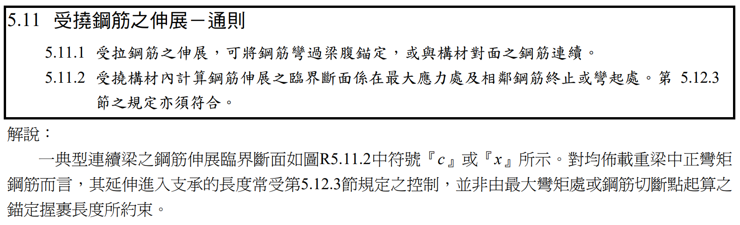

Slide 3
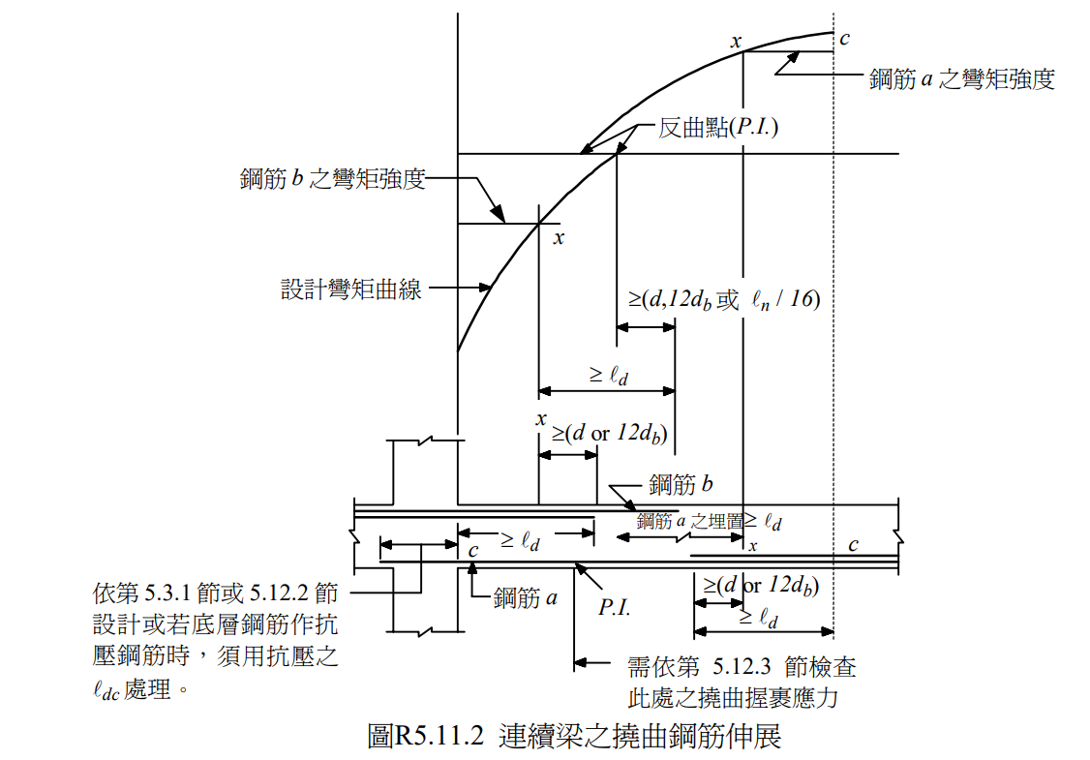

Slide 4
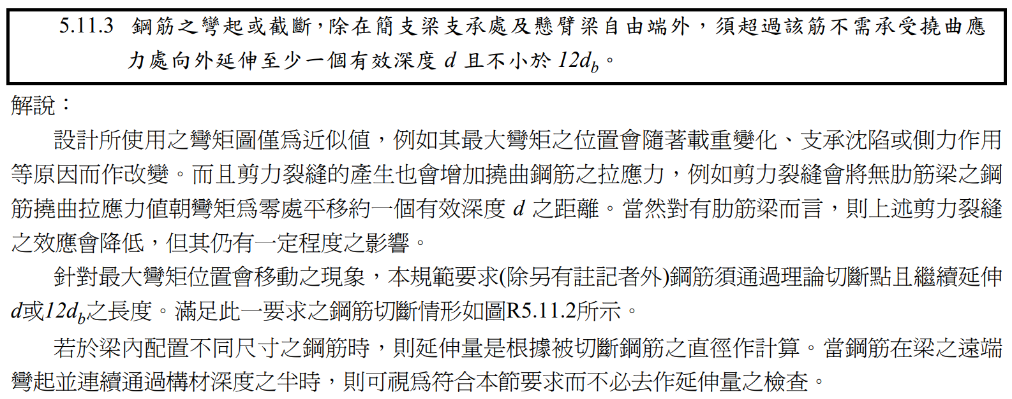

Slide 5
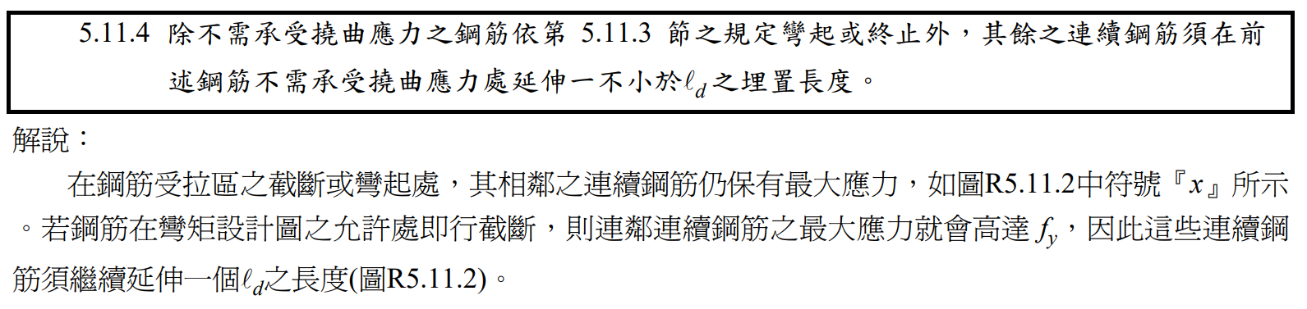

Slide 6
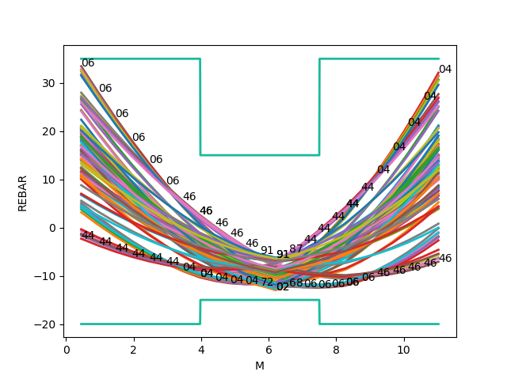
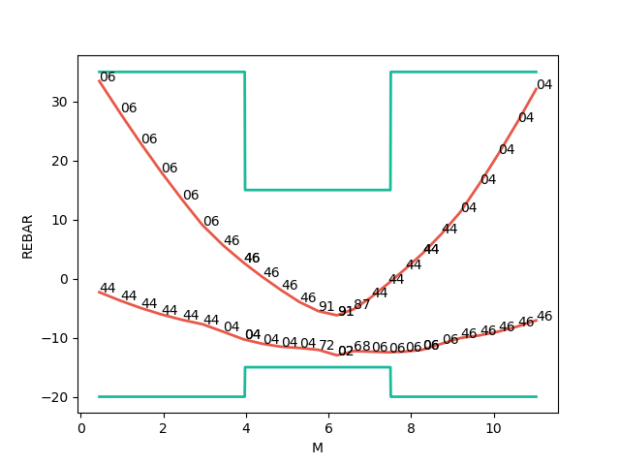
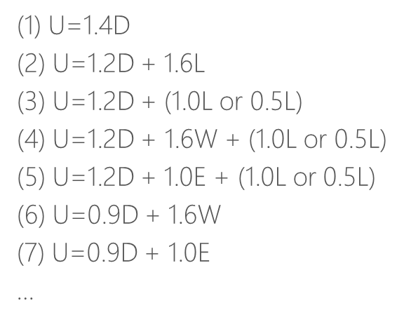


Mu
Consider Hundreds Of Combo Demand
Catch Critical Demand Combo
$$A_{s}({cm}^{2})$$
$$A_{s}({cm}^{2})$$
Length(m)
Length(m)

Slide 7
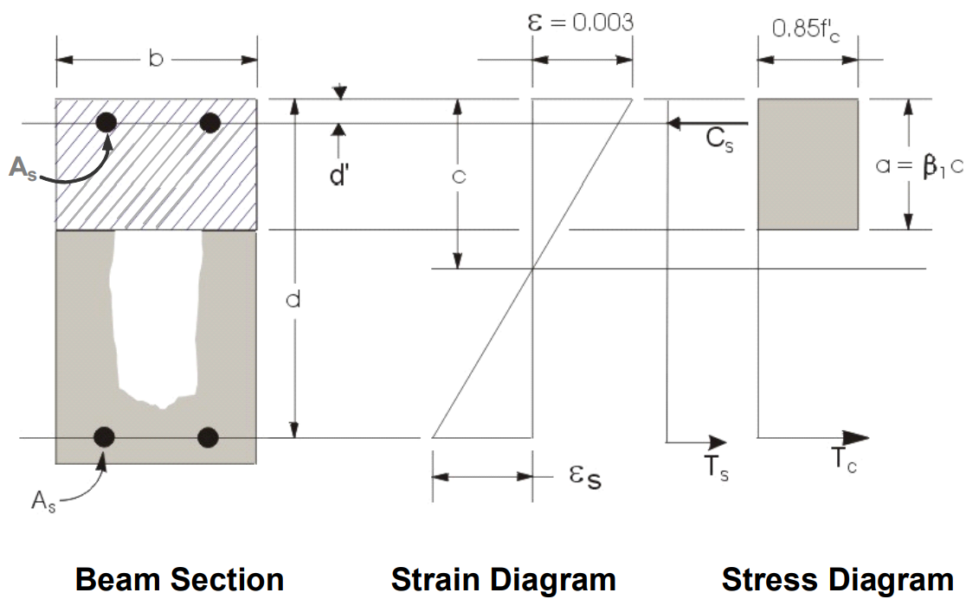
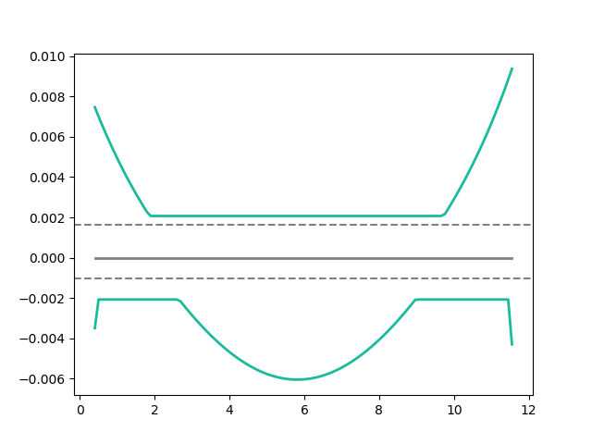
Flexural Reinforcement
- Demand As
Min: 2 Rebar
Notes:
LowSeismic 4Floor 12M 0

Slide 8
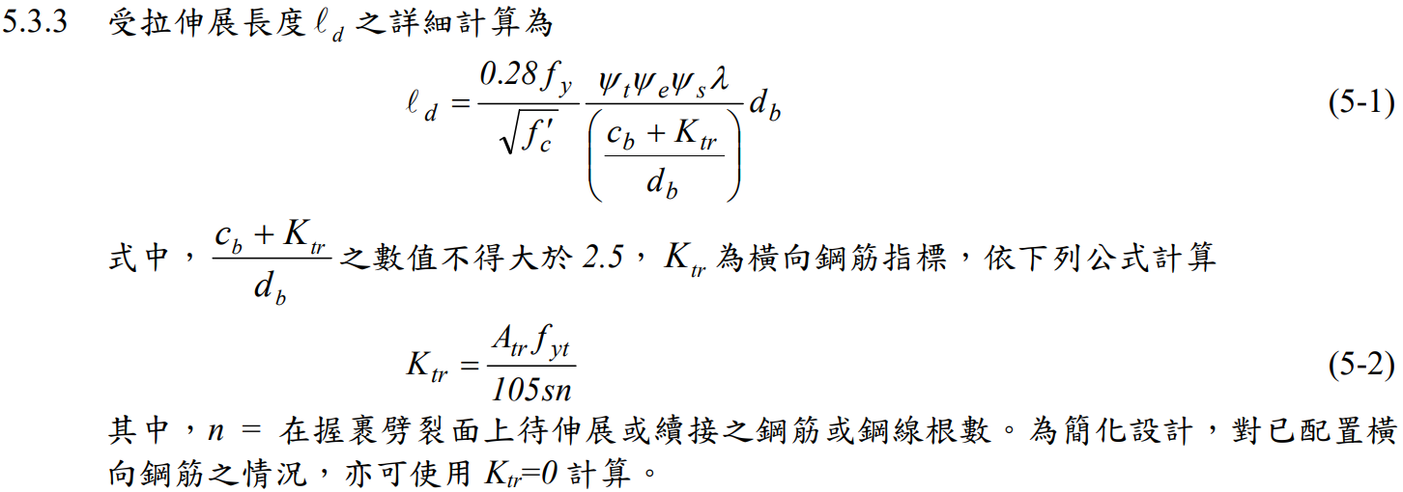
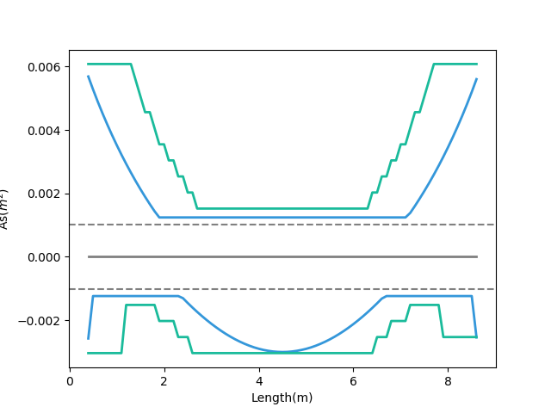
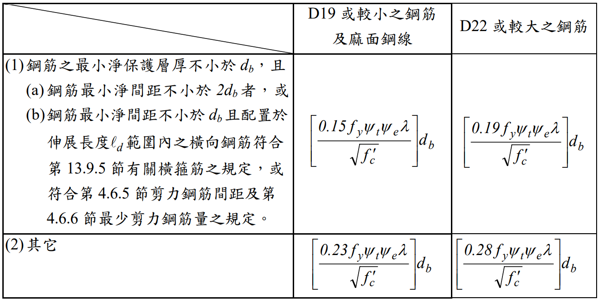
General Development Length Equation
- Demand As
- After Consider Ld As
Top
MIN
Simplified Provisions
Bottom
Ld
Notes:
LowSeismic 4Floor 12M 0

Slide 9
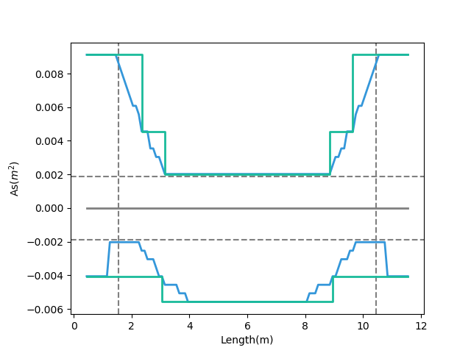
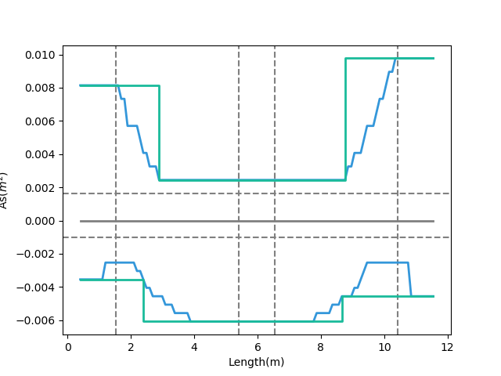
Combinations
Multi-Cut-4
Multi-Cut-2
- Consider Ld
Top
Bottom
0.1
Ln
0.9
Ln
- Consider Ld
Notes:
GA 演算法
LowSeismic 4Floor 12M 4
LowSeismic 4Floor 12M 0

Slide 10
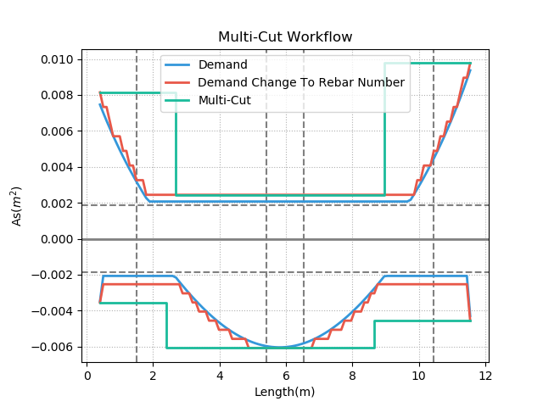
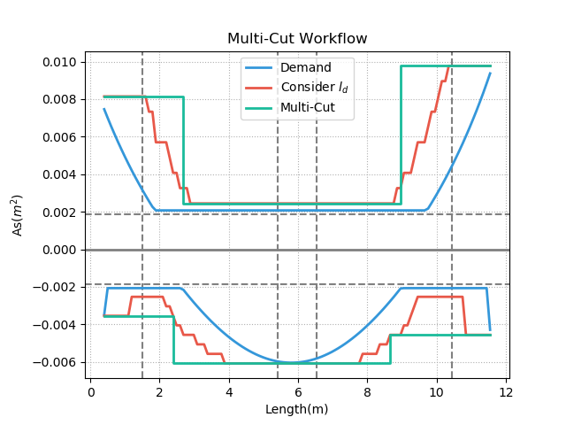

Slide 11
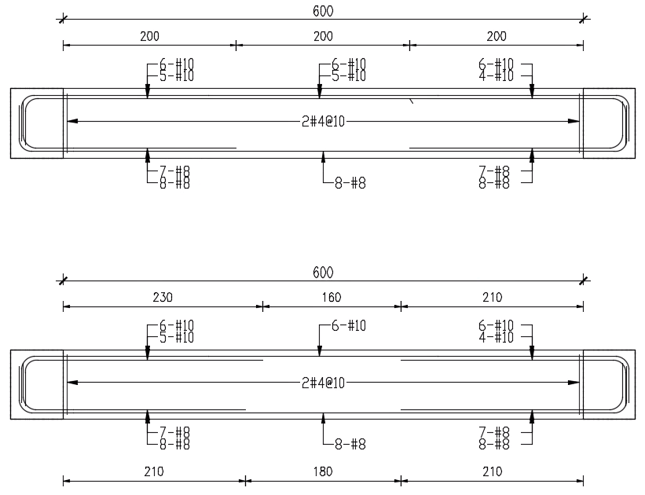
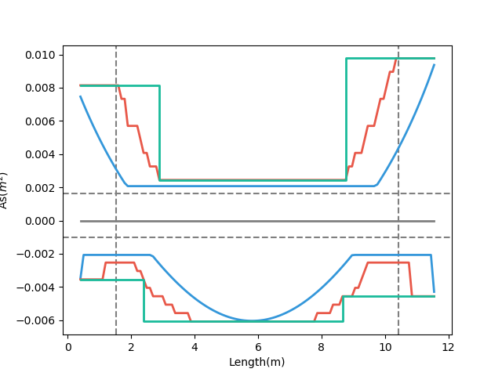
- Demand As
傳統梁鋼筋配置圖
- Consider Ld As
- Design As
Multi-Cut-2
多點斷筋梁鋼筋配置示意圖
Notes:
LowSeismic 4Floor 12M 0

Slide 12
